Slide 1
Navigating uncertainty and rISk: KALMAN FILTERS IN finance
Brief Introduction and q/kdb+ Implementation
Mark B. Lefevre

Slide 2
KALMAN FILTER In Finance
Powerful statistical tool used for estimating the true state of financial and economic systems in the presence of noise and uncertainty
Real-Time Estimation: Recursive algorithm ideal for dynamic environment
Two Step Process:
Predict – Estimate current state variables (e.g. asset prices, volatility, etc.)
Update – Adjust predictions based on new data, using a weighted average of past estimates and current observations
Key Applications in Finance:
Noise Reduction: Filter out market noise for better insights
State Estimation: Estimate latent variables
Adaptive Models: Quickly adjust to market changes, make real-time decisions
Portfolio Optimization: Dynamically update return and covariance estimates
Notes:
Bayesian Connection
-Have a belief about the state of the world
-Ingest new measurements/data
-If the new data contradicts my belief,
I am less certain about my belief and I slightly update my belief
-If it supports my belief
I am more certain and I don’t update
-Useful when you already have a model

Slide 3
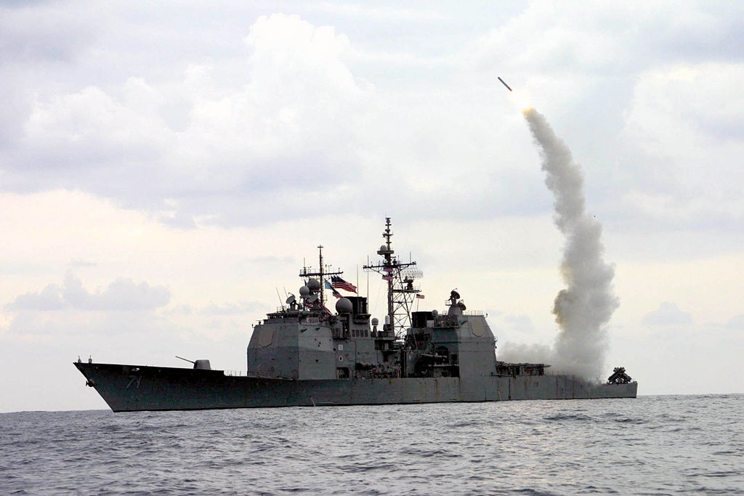
Broader APPLICATIONS of KALMAN FILTERs
Navigation/GPS
Aerospace
GPS/Inertial Navigation Systems (INS)
Autonomous Vehicles
Self Driving (sensor fusion, obstacle avoidance)
Path Planning
Robotics/Control Systems
Signal Processing
Medical
Heart Rate Monitoring
Medical Imaging
Tracking/Surveillance
Notes:
Aeronautics
navigation of US Navy ballistic missile submarines
guidance and navigation of US Navy Tomahawk missile
US AF Air Launched Cruise Missile
Robotics, autonomous vehicles
Economics
Estimate parameters for ARMA models
Modeling regime changes
Forecasting economic indicators
Finance
Simple example: replace moving averages
Estimate beta (which is an extremely noisy quantity using returns)
Can compute rolling estimates
Avoids having to choose a finite lookup window
Dr. Aidan O’Mahoney has a cool blog
http://www.thealgoengineer.com/2014/online_linear_regression_kalman_filter/
Subject of lots of academic research and widely applied in many different industries

Slide 4

PAIRS TRADING
Market-neutral strategy
Need two correlated assets
Often one asset is a hedge
Market volatility impacts the effectiveness of hedges
Periodic adjustment
When price relationship diverges from normal
Take L/S positions
Expect mean reversion
Dynamic Spread Estimation:
$Spread\left(t\right)=P_{1}(t)−P_{2}(t)$ $+ε\left(t\right)$
Predict spread
State is difference
Additional element could be spread velocity
Dynamic Hedge Ratio Estimation:
$P_{1}\left(t\right)=β\left(t\right)P_{2}(t)+ε\left(t\right)$
Predict hedge ratio
State is the intercept and slope of continuous OLS regression
Notes:
Aerodynamic drag is also known as air resistance
Winds/Weather
Gusty near the ground
Fast high-altitude jet stream
Humidity, Precipitation
Coriolis Effect is the deflection of the trajectory due to the spinning of the Earth. Even in long-range sniping this becomes important at around 1000 meters. Targets can rise or drop about 6 inches depending if you are shooting east (rise) or west (fall). North/South results in 3 inches move left (Southern Hemisphere) or right (Northern Hemisphere).
Earth Curvature Earth is actually an oblate spheroid. The radius at the equator is greater than at the poles.
ICBMs typically have multiple stages. The LGM-118A Peacekeeper has 4 propulsion stages. 3, solid-fuel and 1, post-boost liquid-fuel for velocity and attitude correction.
Ballistic Trajectory is also called Projectile Motion
Timed exposure shows 10 MK-21 re-entry vehicles (RV) approaching an open-ocean impact zone near Kwajalein Atoll during a flight test
These would ride inside an American LGM-118A Peacekeeper ICBM
Typical ICBMs have a range of 10k km and a speed of around 7km/s
Image Source:
https://en.wikipedia.org/wiki/File:MIRV-Reentry.jpg

Slide 5

Measurement Problem
Actual state of the system is not directly observable
Any measurement of the system outputs are unavoidably noisy
Process Model
$$x_{k}=Ax_{k−1}+Bu_{k}+w_{k−1}$$
Measurement Model
$$z_{k}=Hx_{k}+v_{k}$$
Process and Measurement Noise
$$p\left(w\right)\sim N\left(0,Q\right) \\ p\left(v\right)\sim N(0,R)$$
Notes:
We want to estimate internal states only by observing the outputs of the system
We use a state-space model
The process model is a linear stochastic difference equation which models the transition of the internal state
The measurement model is a linear stochastic equation which represents the measure of the current state
The measurement does not have to be all the state element and can be any linear combinations of them
Measurement errors can be due to sensor limitations, electrical noise, atmospheric conditions, etc.
Actual state transitions are completely unknown
Process models intentionally incorporate notions of random motion for the reasons mentions in realistic ballistic trajectories
w_k-1 and v_k are random variables
Assume that noises are independent zero mean Gaussians

Slide 6

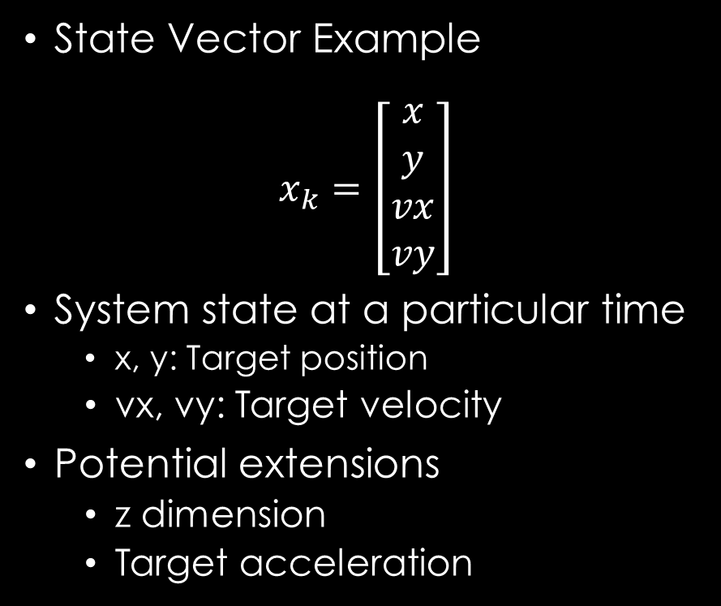
State-Space Model
Discretize Equations
Use matrix notation
$$x_{k}=Ax_{k−1}+Bu_{k}$$
A, State Transition Model
B, Control-Input Model
$x_{k}$, current state
$x_{k−1}$, previous state
$u_{k}$, static vector
State Vector Example
$$x_{k}=\left[\begin{matrix}x \\ y \\ vx \\ vy\end{matrix}\right]$$
System state at a particular time
x, y: Target position
vx, vy: Target velocity
Potential extensions
z dimension
Target acceleration
Notes:
Note the state space model doesn’t include the error
State example is just an example. Here our state contains the x,y position and the x,y velocities.
It could be anything depending on your model.
In a financial context, it could be price, volatility, interest rate, volatility, liquidity, dividend yield (equities), maturity (fixed income)

Slide 7
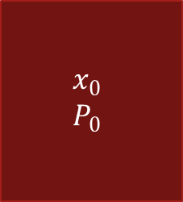



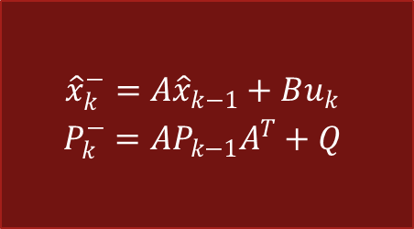
A Kalman Filter
Initial State
Predict
Choice an Initial State
Predict
Project the state
Project the error covariance
Correct
Compute the Kalman Gain
Update estimate with measurement
Update the error covariance
$$\begin{matrix}x_{0} \\ P_{0}\end{matrix}$$
$$\begin{matrix}{\hat{x}}_{k}^{−}=A{\hat{x}}_{k−1}+Bu_{k} \\ P_{k}^{−}=AP_{k−1}A^{T}+Q\end{matrix}$$
Correct
$$\begin{matrix}K_{k}=\frac{P_{k}^{−}H^{T}}{HP_{k}^{−}H^{T}+R} \\ \left.{\hat{x}}_{k}={\hat{x}}_{k}^{−}+K_{k}(z_{k}−H{\hat{x}}_{k}^{−}\right) \\ P_{k}=\left(1−K_{k}H\right)P_{k}^{−}\end{matrix}$$
$${\hat{x}}_{k}$$
$$z_{k}$$
Notes:
Kalman filters are based on linear dynamical systems discretized in the time domain
Examine the Kalman Gain in detail in 2 slides

Slide 8

DISCRETE Kalman Filter
Predictor-Corrector Estimator
Maintains 2 statistical moments (state, error covariance)
Minimizes Error Covariance
Define a priori and a posteriori Estimate Errors
$$e_{k}^{−}≡x_{k}−{\hat{x}}_{k}^{−}$$
$$e_{k}≡x_{k}−{\hat{x}}_{k}$$
Estimate a priori and a posteriori Covariances
$$P_{k}^{−}=E\left[e_{k}^{−}{e_{k}^{−}}^{T}\right]$$
$$P_{k}=E\left[e_{k}{e_{k}^{−}}^{T}\right]$$
Compute a posteriori State Estimate
$${\hat{x}}_{k}={\hat{x}}_{k}^{−}+K(z_{k}−H{\hat{x}}_{k}^{−})$$
Notes:
Compute a prosteriori state estimate as a linear combination of a prior estimate and weighted difference between an actual measurement and a measurement prediction
Difference term in red is called the measurement innovation or the residual.
The residual is the discrepancy between the predicted measurement and the actual measurement

Slide 9

Kalman Gain
Kalman Gain is Chosen to Minimize a posteriori Error Covariance
$K_{k}=\frac{P_{k}^{−}H^{T}}{HP_{k}^{−}H^{T}+R}$
Blending Factor which weights the a priori Estimated State and the Measurement
Value is between 0 and 1
As Measurement Error Covariance R tends to 0
Residual has more weight
As a priori Estimated Error Covariance $P_{k}^{−}$ tends to 0
a priori Estimated State has more weight
Notes:
Kalman Gain decides the relative weight given to the measurements and current state estimate
High gain (close to 1), the filter places more weight on the most recent measurements, and thus is more reactive, could give jumpy trajectory estimates
Low gain (close to 0), the filter follows the model predictions more closely. This effectively smooths out noise but decrease the responsiveness

Slide 10
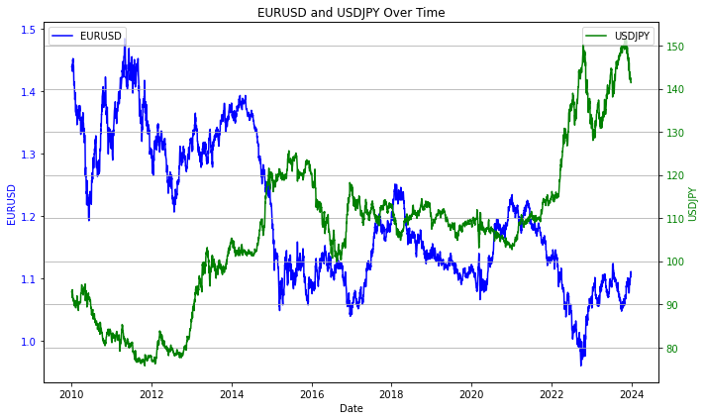

Kalman Filter Dynamic SPREAD ESTIMATION EURUSD versus USDJPY
State Vector
$$x_{k}=\left[\begin{matrix}s \\ v\end{matrix}\right]$$
s: spread between EURUSD and USDJPY
v: velocity (change in spread)

Slide 11
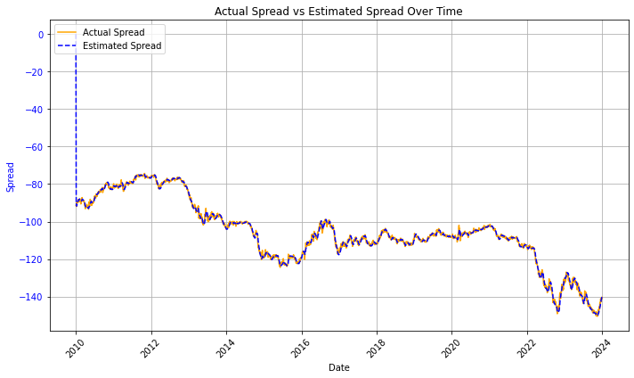
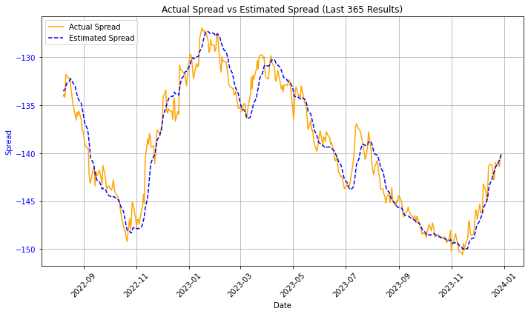
Kalman Filter Dynamic SPREAD ESTIMATION EURUSD versus USDJPY

Slide 12
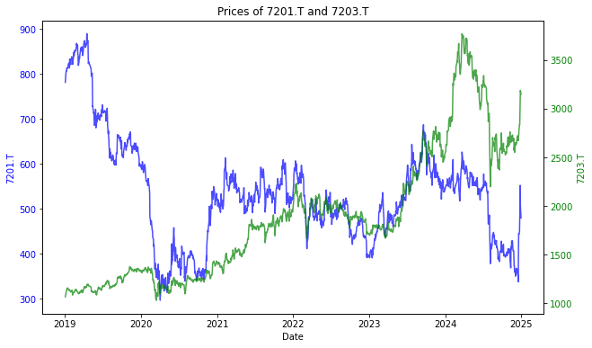
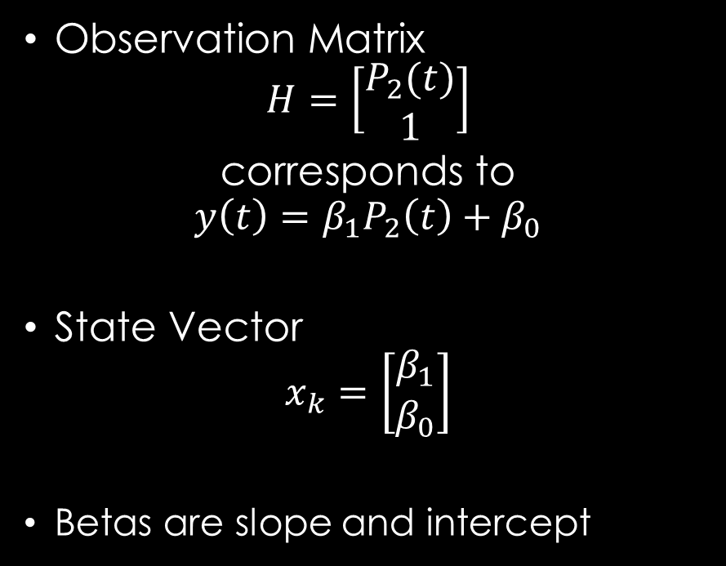
Kalman Filter Dynamic Hedge Ratio Toyota (7203.T) and NISSAN (7201.T)
Observation Matrix
$$H=\left[\begin{aligned}P_{2}(t) \\ 1\end{aligned}\right]$$
corresponds to
$$y\left(t\right)=β_{1}P_{2}\left(t\right)+β_{0}$$
State Vector
$$x_{k}=\left[\begin{matrix}β_{1} \\ β_{0}\end{matrix}\right]$$
Betas are slope and intercept
Notes:
These results were created with q/kdb+ code, saved to a csv file and plotted in Python using matplotlib.
There is an element of randomness, so unless your seed value was the same, the results will be slightly different.
In the reference q/kdb code, the seed is set for reproducibility.
The first plot shows the true location in the x and y dimensions in green.
The red dots are the measured position which includes measurement noise.
The blue dots are the estimated positions.
The middle plot shows the true velocities in green. The ballistic target starts with velocities in both directions of 50 m/s. The x velocity is unchanged as we are not simulating are drag. The y velocity decreases under the influence of gravity.
As in the position measurement, there is noise in the velocity measurement although we have set it to a different value.
The velocity estimate begins at 0,0 and quickly starts to converge closer to the true velocities.
The third plot shows the Kalman gain for the positions and velocities. The Kalman gain is a mxn matrix where the m is the number of state variables and n is the number of measurements. The diagonal elements of the Kalman Gain matrix represent the gain for each individual state variable (e.g., position, velocity, etc.). These diagonal elements determine how much of a correction will be applied to the state estimate for each state variable based on the measurement residuals. Larger diagonal elements indicate more trust in the measurements for that specific state variable, and smaller diagonal elements indicate more trust in the model predictions. The model initially places more trust in the measurements, but over time, it starts relying more on the estimated state. In the beginning, it comparatively trusts the velocity measurements more that the position measurement.

Slide 13
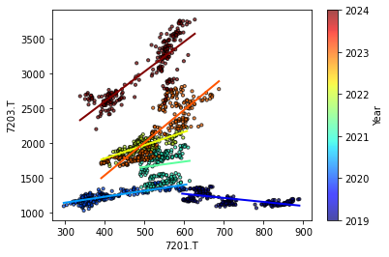
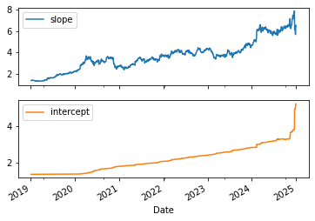
Kalman Filter Dynamic Hedge Ratio Toyota (7203.T) and NISSAN (7201.T)
Notes:
These results were created with q/kdb+ code, saved to a csv file and plotted in Python using matplotlib.
There is an element of randomness, so unless your seed value was the same, the results will be slightly different.
In the reference q/kdb code, the seed is set for reproducibility.
The first plot shows the true location in the x and y dimensions in green.
The red dots are the measured position which includes measurement noise.
The blue dots are the estimated positions.
The middle plot shows the true velocities in green. The ballistic target starts with velocities in both directions of 50 m/s. The x velocity is unchanged as we are not simulating are drag. The y velocity decreases under the influence of gravity.
As in the position measurement, there is noise in the velocity measurement although we have set it to a different value.
The velocity estimate begins at 0,0 and quickly starts to converge closer to the true velocities.
The third plot shows the Kalman gain for the positions and velocities. The Kalman gain is a mxn matrix where the m is the number of state variables and n is the number of measurements. The diagonal elements of the Kalman Gain matrix represent the gain for each individual state variable (e.g., position, velocity, etc.). These diagonal elements determine how much of a correction will be applied to the state estimate for each state variable based on the measurement residuals. Larger diagonal elements indicate more trust in the measurements for that specific state variable, and smaller diagonal elements indicate more trust in the model predictions. The model initially places more trust in the measurements, but over time, it starts relying more on the estimated state. In the beginning, it comparatively trusts the velocity measurements more that the position measurement.

Slide 14
q/KDB+ Code
/ Constants
g:9.81; / gravity m/s^2
/ Time steps
dt:0.1;
/ [b]egin; [e]nd; [s]tep
arange:{[b;e;s] b+s*til "j"$-[e;b]%s};
times:arange[0;10;dt];
/ Initial conditions
x0:0; y0:0; vx0:50; vy0:50; / pos in m; vel in m/s
/ Actual trajectory
atraj:{[g;x0;y0;vx0;vy0;t]
x:x0+vx0*t; / x pos
y:-[y0+vy0*t;0.5*g*t*t]; / y pos y0+vy0*t-0.5*g*t^2
vx:vx0; / x vel (no air resistance)
vy:vy0-g*t; / y vel (gravity but no air res)
(x;y;vx;vy)};
act_traj:atraj[g;x0;y0;vx0;vy0;];
/ Simulate actual trajectory
true_traj:act_traj[times]; / use the projection
Notes:
Over the next four slides, I will show the q code to implement a Kalman Filter for a simple ballistic target.
It is not important to understand each line, but perhaps you can understand the broad strokes. Much of the code is setting up data, initialization and writing it out for plotting in Python.
The left hand side establishes some constants, time steps and initial conditions.
The right hand side defines a generic function to compute the actual trajectory given a time.
It then defines a projection for these specific initial conditions. It then simulates the actual trajectory for the all the times.

Slide 15
q/KDB+ Code
/ Simulate measurements
pos_meas_noise:1.0; / standard dev of position measurements
vel_meas_noise:0.5; / standard dev of velocity measurements
/ Use Nick Psaris Box Muller algorithm for
/ generating pairs of independent, standard normally distributed
/ random variables from uniformly distributed random variables
meas_traj:true_traj+
*[(pos_meas_noise;vel_meas_noise)0 0 1 1;] / scale std dev
(4 0N)#.stat.bm*[4;count times]?1f; / measurement errors
id:{(2#x)#1,x#0}; / Identity matrix from qphrasebook
/ Kalman Filter
/ Initialization
/ State vector [x, y, vx, vy]
x_est:(4;count times)#0f;
P:"f"$id 4; / State Covariance matrix
R:*[(pos_meas_noise;vel_meas_noise)0 0 1 1;]
"f"$id 4; / Measurement Noise Covariance
Q:0.005*"f"$id 4; / Process Noise Covariance
F:"f"$id 4; / State Transition Matrix
F:(@[F 0;2;+;dt];@[F 1;3;+;dt];F 2;F 3);
H:"f"$id 4; / Measurement Matrix (pos and vel)
G:(4;4;count times)#0f;
Notes:
The code on the left hand side defines some noise parameters and computes a times series of noisy measurements.
The measurement noise is normally distributed.
I take advantage of the Box Muller algorithm for computing pairs of standard normally distributed variables from uniform draws.
Once the standard derivations are properly scaled, it is added to the true state.
On the right hand side, I define a function from the q phrasebook and set up some initializations.

Slide 16
q/KDB+ Code
/ KF Prediction Step
// Predict next state using prev state and the F, state transition matrix
// Predict state uncertainty (update P, covariance matrix using Q, process noise
predictState:{[F;ps;P;Q]
ns:F$ps; / predicted next state
nP:$[F;$[P;flip F]]+Q; / predicted next P
(ns;nP)
};
// Kalman Gain (K) weight of measurement vs prediction
// done in the update step
computeKalmanGain:{[H;pP;R]
S:$[H;$[pP;flip H]]+R; / intermediate matrix for inversion
K:$[pP;$[flip H;inv S]] / inv uses LU decomposition
};
/ KF Update Step
// Update corrects predicted state with new measurement
// Kalman Gain (K) adjusts predicted state based on the measurement residual
// Update state estimate and uncertainty (covariance)
updateStateEstimate:{[H;pP;R;ms;ps]
id:{(2#x)#1,x#0};
I:"f"$id 4; / Identity Matrix
K:computeKalmanGain[H;pP;R];
y:ms-$[H;ps]; / measurement residuals
es:ps+$[K;y]; / new state estimat
P:$[I-$[K;H];pP];
(K;es;P)
};
Notes:
This slide contains the meat of the Kalman Filter. There are two basic steps in the Kalman Filter: prediction and update. There is a third function defined here for computing the Kalman Gain which I factored out for maintainability.

Slide 17
q/KDB+ Code
// Run the Kalman Filter
idx:0;
res:();
ps:(); pP:();
es:(); cP:();
while[idx<-1+count times;
idx+:1;
res:predictState[F;x_est[;idx-1];P;Q];
ps:res 0; pP:P:res 1;
res:updateStateEstimate[H;pP;R;meas_traj[;idx];ps];
G[;;idx]:res 0; x_est[;idx]:res 1; P:res 2;
];
// Create table(s) for visualization
tms:flip ![enlist `time;enlist times];
est:flip ![`x`y`xv`yv;x_est];
true:flip `truex`truey`truexv`trueyv!true_traj;
meas:flip `measx`measy`measxv`measyv!meas_traj;
kgains:flip `gainx`gainy`gainxv`gainyv!{G[x;x;::]} each til 4;
data:(,')over(tms;est;true;meas;kgains);
save `:./data.csv;
Notes:
Once all the initialization and function definitions are complete, we want to run the Kalman Filter over the measured values. Although good q programmers avoid loops, I thought it would be clearer to iterate over time using a while loop.
The right hand side creates a bunch of tables, joins them together sideways and writes out a data.csv.
In a previous iteration of this presentation I used Excel to graph the results, but am now using matplotlib in Python

Slide 18
EXTENSIONS
Extended Kalman Filter (EKF)
Non-linear SS Models
Linearize with First Order Taylor’s
Unscented Kalman Filter (UKF)
Better than EKF for non-linear
Uses Sigma Points to capture distribution and propagate it through transformation
Central Kalman Filter (CKF)
Very computational expensive
Accuracy is priority over efficiency
Distributed Kalman Filter (DKF)
Uses distributed microfilters and a consensus filter
Useful for decentralized trading systems
Ensemble Kalman Filter (EnKF)
Ensemble of state vectors approximates the state distribution
Notes:
Notes for Finance:
Applications in Finance: These extended filters are often applied to model more complex, non-linear processes, such as asset price predictions, option pricing, and managing risk in portfolios.
Non-linear Dynamics: Many financial systems are inherently non-linear, which makes filters like the EKF and UKF essential tools in more sophisticated modeling.

Slide 19
Kalman Filter Summary
Optimal State Estimation: For linear systems, minimizes estimation error
Real-Time, Computational Efficient: fits q/kdb+ paradigm well
Uncertainty Qualification: Provides an estimation uncertainty measurement, critical in risk management and system trading
Robust to Noisy Data: handles noisy financial data
Finance Applications: pairs trading, portfolio optimization, volatility forecasting, risk management, asset pricing,etc.
Straightforward to implement: efficient real-time analytics and predictive modeling in q/kdb+
Notes:
It is optimal if:
Model perfectly matches the real system
Noises are uncorrelated and white
Covariances of white noise are known
Robust
-Stable given common conditions and forgiving in many way
Give special thanks to
Dr. Chris Kubelek for inspiring my initial interest in Kalman Filters
Dr. Hizuru Konishi for being a fantastic sempai and mentor at MUFG Bank
Dr. Laurent Calvet at EDHEC

